Slide 1
Wordle Remix Web App
By: Terrence Blocker For CIS 228

Slide 2
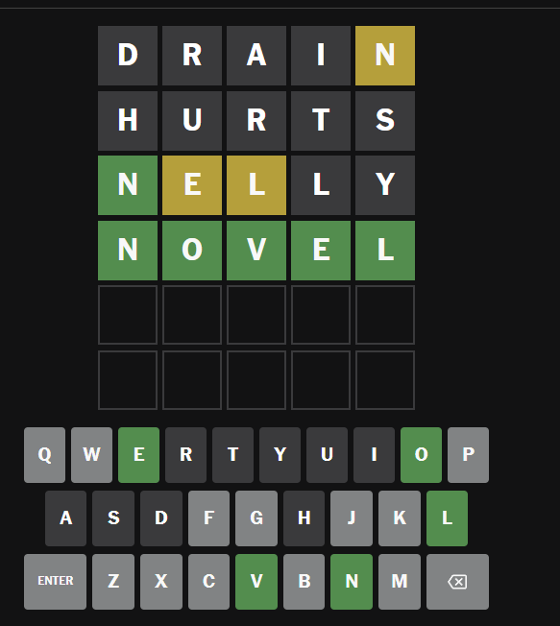
What is Wordle Remix
Wordle
Wordle Remix heavily inspired by Wordle: the five letter word web guessing game has similar aspects with the guessing game. However this is my spin on things, instead of just five letter words this time it’s themed. The idea is to have two to possibly three game modes from guess the words, guess the quoter, or guess the sentence/saying.

Slide 3
Wordle Remix: Game Modes
Each game mode would contain an array of commonly used words to the most uncommon words, frases, and sentences. The goal is to inspire people to look more into using different words not to sound fancy but to broaden their language. Daily Word Mode: Classic 5 letter word guessing Quote Challenge Mode: Guess who said a famous quote. Mystery Sentence Mode: Unscramble a sentence

Slide 4
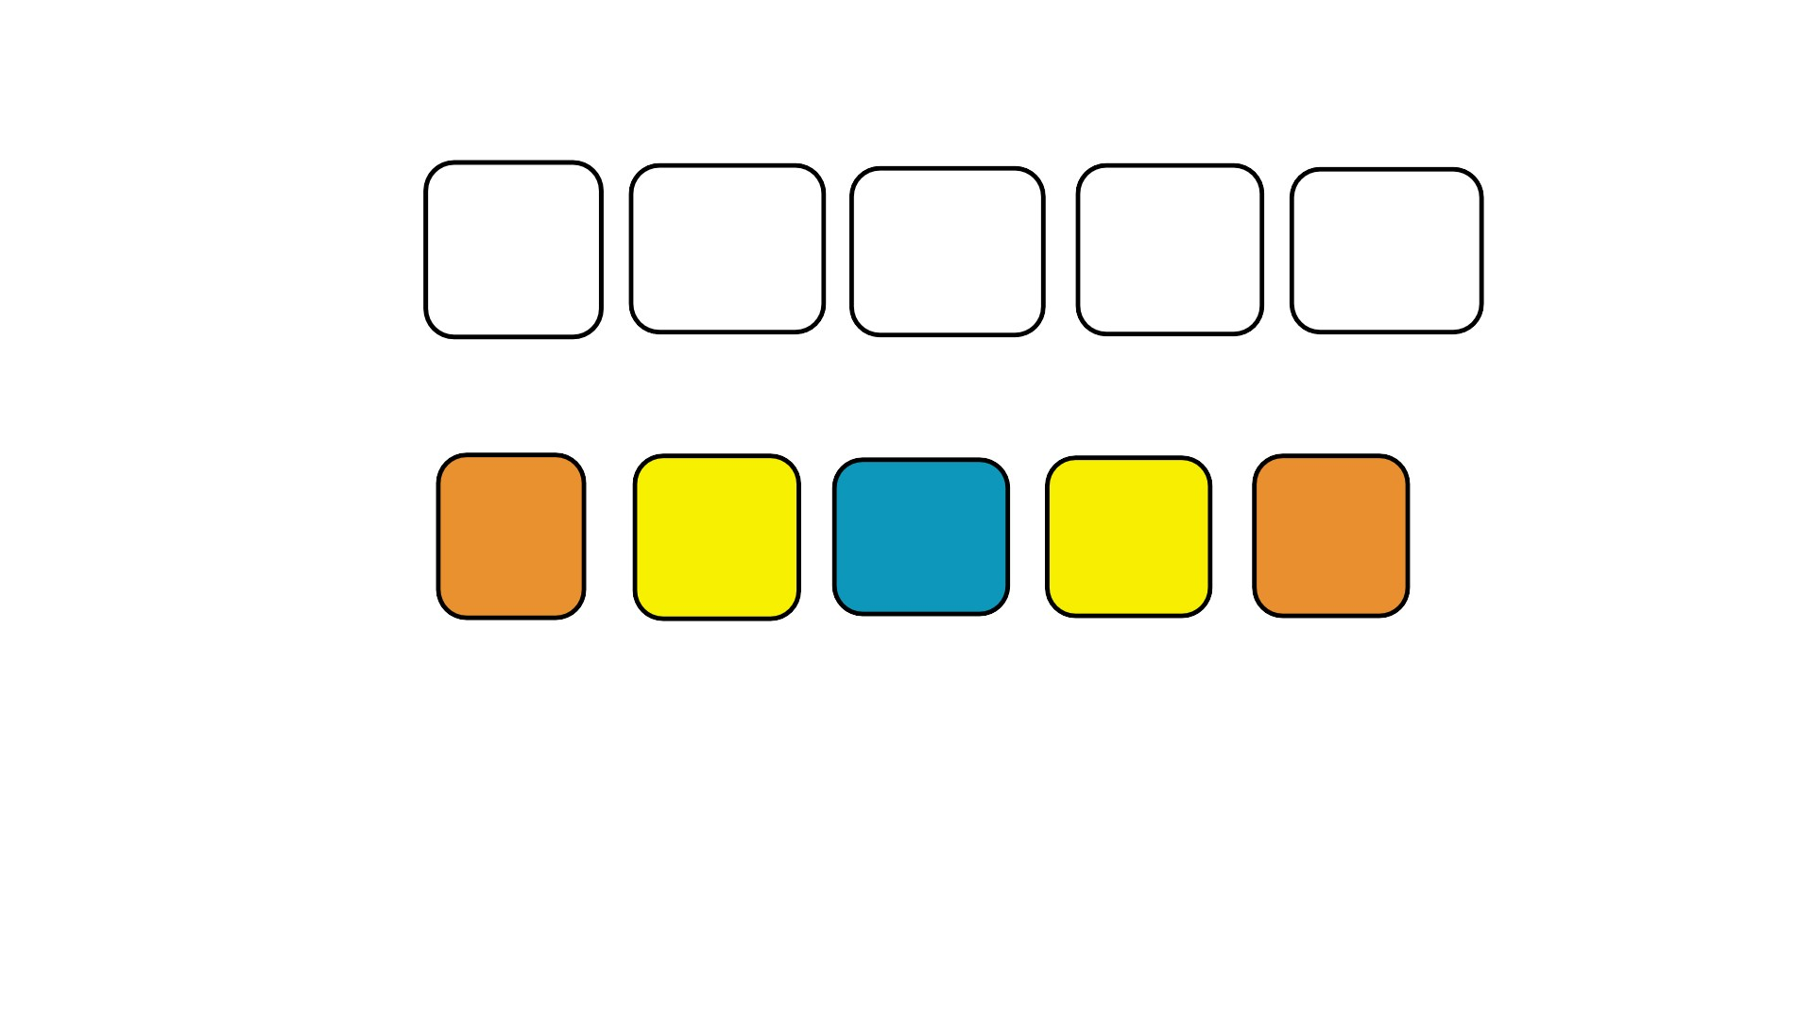
Wordle Remix: Core Game Features
On the top of the photo ( the blank white boxes this will be how the game starts with you trying to figure the word out. The bottom would resemble an attempt The color meaning Orange: Correct Letter, Correct Spot Yellow: Correct Letter, Wrong Spot Blueish-green: Not in the word

Slide 5
Wordle Remix: Core Game Features continued
There will be radio buttons and a drop down to swap the game modes and the themes. Not only that but so you won’t be left in the dark there will be a clue button that will give you three clues all related to the prompt/word that you want to find. If you feel like you need to reset the reset button will be there to allow you to refresh and try again.

Slide 6
The Tech and The Structure
Languages HTML, CSS, and Javascript will be used to create the base of the website HTML, CSS, and Javascript are used to create websites HTML is the body, CSS is the looks, and JavaScript is like the brain of the body
Data & Storage JSON will hold all the word and quotes
There will be a localStorage for the user so they can have a high score. Modular Javascript files to make sure that the design won’t be next to the data and etc.

Slide 7
How It Works
Player chooses a game mode
A random word/quote/sentence is selected.
Player inputs their guess
Feedback is given after each guess
Game ends after correct guess or 6 attempts

Slide 8
Wordle Remix: Educational Value
The educational Value is to teach others about the different cultures outside of their daily lives, not only that but it gets your brain thinking and instant gratification isn’t all that great. When it comes to doing stuff sometimes the inbetween finding the solution to a problem can be fun.
It can be later on Customizable for different users ( student, educators, or hobbyists ).

Slide 9
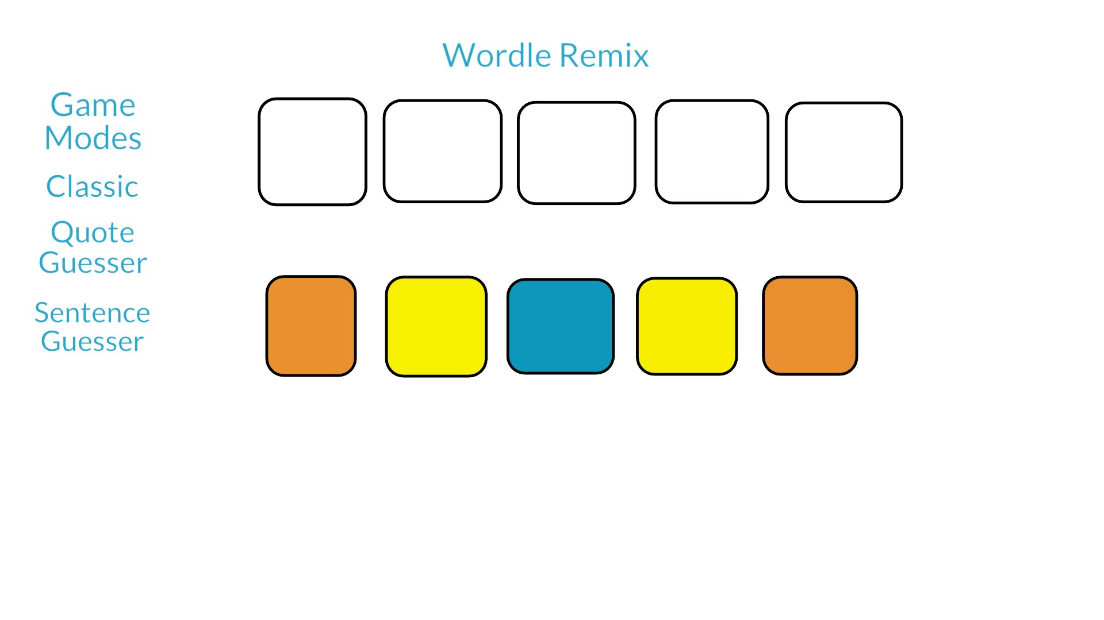
Empty Concept

